Slide 1


Ayushi Gupta
07-11-2023

Slide 2

Outline
Executive Summary
Introduction
Methodology
Results
Conclusion
Appendix

Slide 3
Executive Summary
Data Collection and Exploration
1. Data was gathered from public sources, including the SpaceX API and SpaceX Wikipedia page.
2. Data was analyzed and explored using SQL, visualization techniques, Folium maps, and interactive dashboards.
3. Relevant features were identified from the collected data.
Data Preprocessing
1. Categorical variables were encoded using one-hot encoding to transform them into binary representations.
2. Data was standardized to ensure consistent scales and improve machine learning performance.
Machine Learning Model Selection
1. GridSearchCV was employed to identify optimal hyperparameters for various machine learning models.
2. Logistic Regression, Support Vector Machine, Decision Tree Classifier, and K-Nearest Neighbors models were developed.
Model Performance Evaluation
1. All machine learning models exhibited similar performance, achieving approximately 83% accuracy in predicting successful SpaceX landings.
2. The need for additional data to enhance model accuracy and make definitive conclusions was acknowledged.

Slide 4
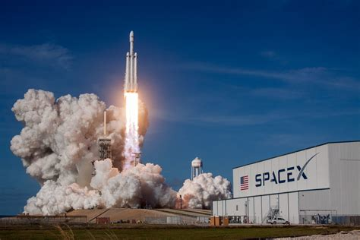
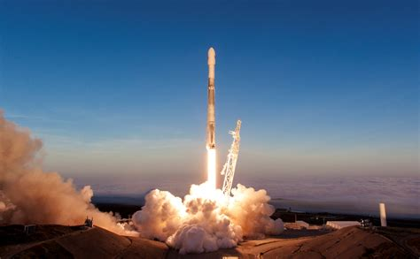
Introduction
Project Overview
SpaceX's Falcon 9 rocket offers the most competitive pricing in the industry, with a launch cost of $62 million compared to its rivals' upwards of $165 million.
This cost advantage is primarily attributed to SpaceX's ability to recover and reuse part of the rocket, specifically the first stage
Project Objectives
Develop a model to predict the price of each SpaceX launch accurately.
Gather and organize publicly available information about SpaceX into a comprehensive dashboard for team members.
Train a machine learning model to forecast the success of SpaceX’s first-stage recovery attempts.

Slide 5

Section 1

Slide 6
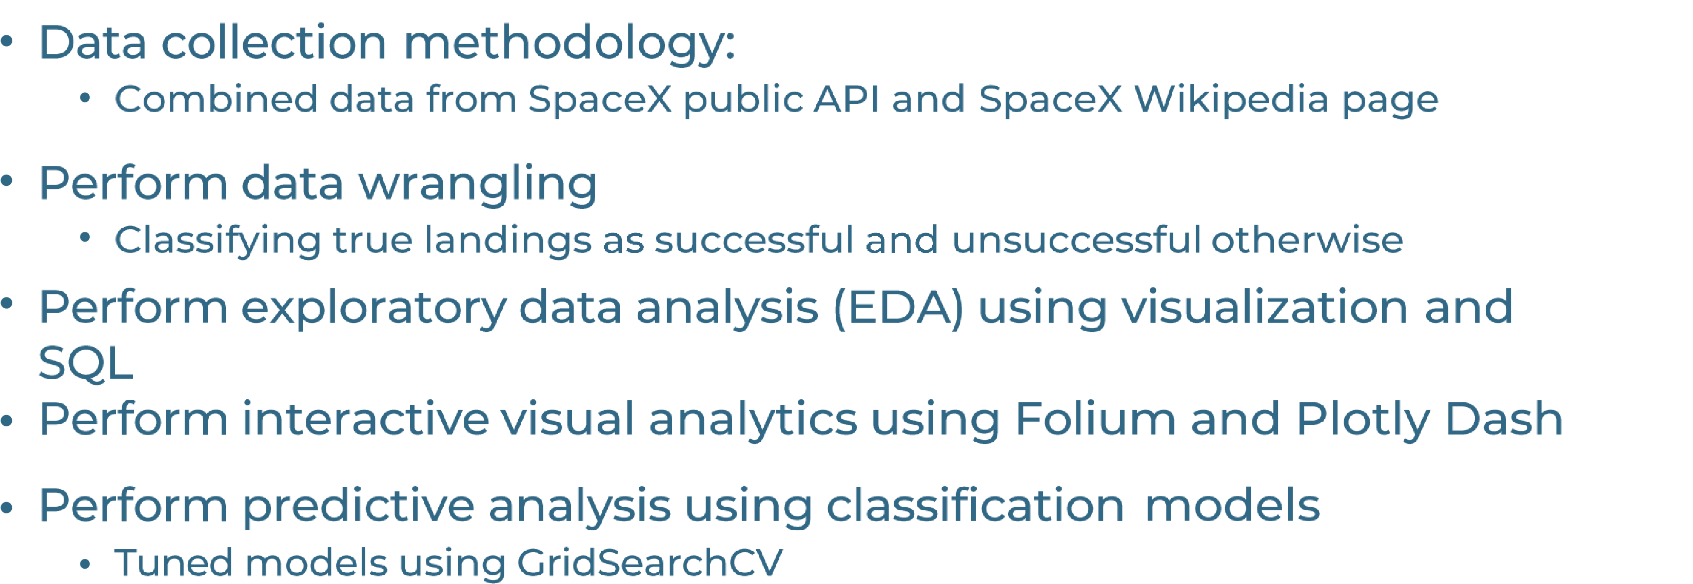
Methodology

Slide 7
Data Collection
The data collection process involved a combination of API requests from Space X public and web scraping data from a table in Space X’s Wikipedia entry.
The following slides show the sequence of processing the data from SpaceX’s public API and the sequence of processing the data from web scraping.
Space X Data Columns:
Flight Number, Data, Booster Version, Payload Mass, Orbit, Launch Site, Outcome, Flights, Grid Fins, Reused, legs, Landing Pad, Block, Reused Count, Serial, Longitude, Latitude
Wikipedia Web Scrape Data Columns:
Flight No, Launch Site, Payload, Payload Mass, Orbit, Customer, Launch Outcome, Version Booster, Booster Landing, Date, Time

Slide 8
Data Collection – SpaceX API
Request SpaceX APIs
.JSON file + Lists(Launch Site, Booster Version, Payload Data)
Json_normalize to DataFrame data from JSON
Dictionary relevant data
Cast dictionary to a DataFrame
Filter data to only include Falcon 9 launches
Replace missing PayloadMass values with mean

Slide 9
Data Collection - Scraping
Request Wikipedia html
BeautifulSoup html5lib Parser
Find launch info html table
Cast dictionary to DataFrame
Iterate through table cells to extract data to dictionary
Create dictionary

Slide 10
Data Wrangling
Creating a training label with landing outcomes where successful = 1 and failure = 0
The outcome column has two components: ‘Mission Outcome’ and ‘Landing Location’
New training label column ‘class’ with a value of 1 if ‘Mission Outcome’ is true and otherwise 0
Value mapping
True ASDS, True RTLS, and True Ocean = 1
None None, False ASDS, None ASDS, False Ocean, False RTLS = 0

Slide 11
EDA with Data Visualization
Exploratory Data Analysis was performed on variables flight number, payload mass, launch site, orbit, class, and year
Plots used:
Flight number vs. payload mass, flight number vs. launch site, payload mass vs. launch site, orbit vs. success rate, flight number vs. orbit, payload vs orbit, and success yearly trend
Scatter plots, line charts, and bar graphs were used to compare relationships between variables to decide if a relationship exists so that they could be used in training the machine learning model.

Slide 12
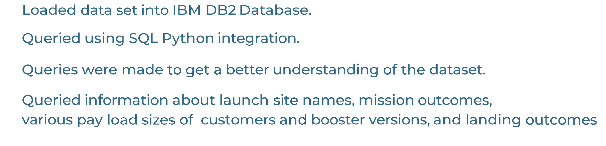
EDA with SQL

Slide 13
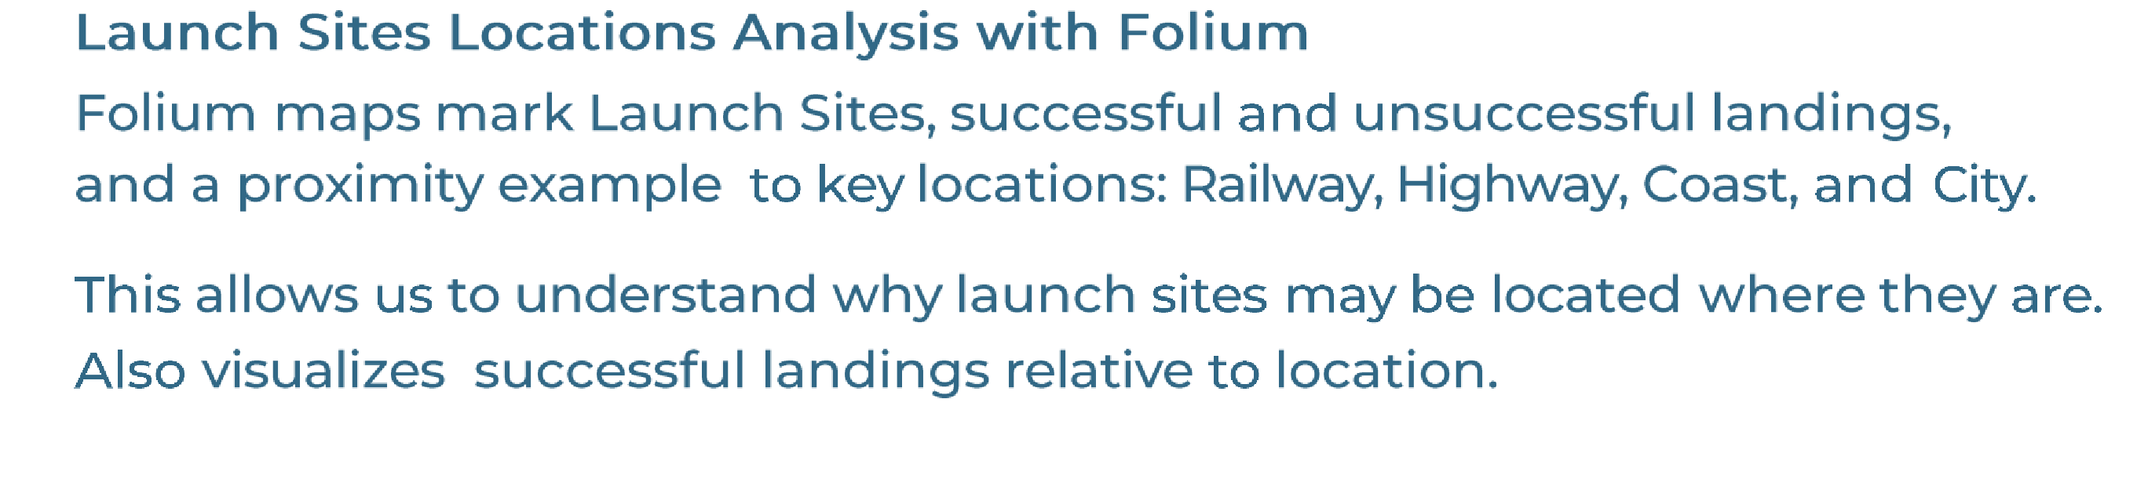
Build an Interactive Map with Folium

Slide 14
Build a Dashboard with Plotly Dash
Import Libraries: Begin by importing the necessary libraries, including dash, dash_core_components (dcc), and dash_html_components (html).
Initialize the Dash App: Create an instance of the Dash app using the dash.Dash() function, assigning it a unique identifier.
Define the App Layout: Utilize the app.layout property to structure the layout of the dashboard, combining HTML components for overall structure and Dcc components for interactive elements.
Create Dash Components: Employ Dcc components to add interactive visualizations to the dashboard. Common components include graphs (dcc.Graph), tables (dcc.DataTable), and dropdowns (dcc.Dropdown).
Connect Components to Data: Establish connections between interactive components and the underlying data sources using callbacks. Callbacks update the displayed data based on user interactions with the components.
Deploy the Dashboard: Deploy the developed dashboard to a hosting platform or embed it within a web application to make it accessible to users.

Slide 15
Predictive Analysis (Classification)
Split label column / Class’ from dataset
Fit and transform features using standard scaler
Train, test and splitt data
Grid SearchCV (cv=10) to find optional parameters
Use GridSearchCV on LogReg, SVM, Decision Trees, and KNN models
Confusion matrix for all models
Barplot to compare scores of models

Slide 16
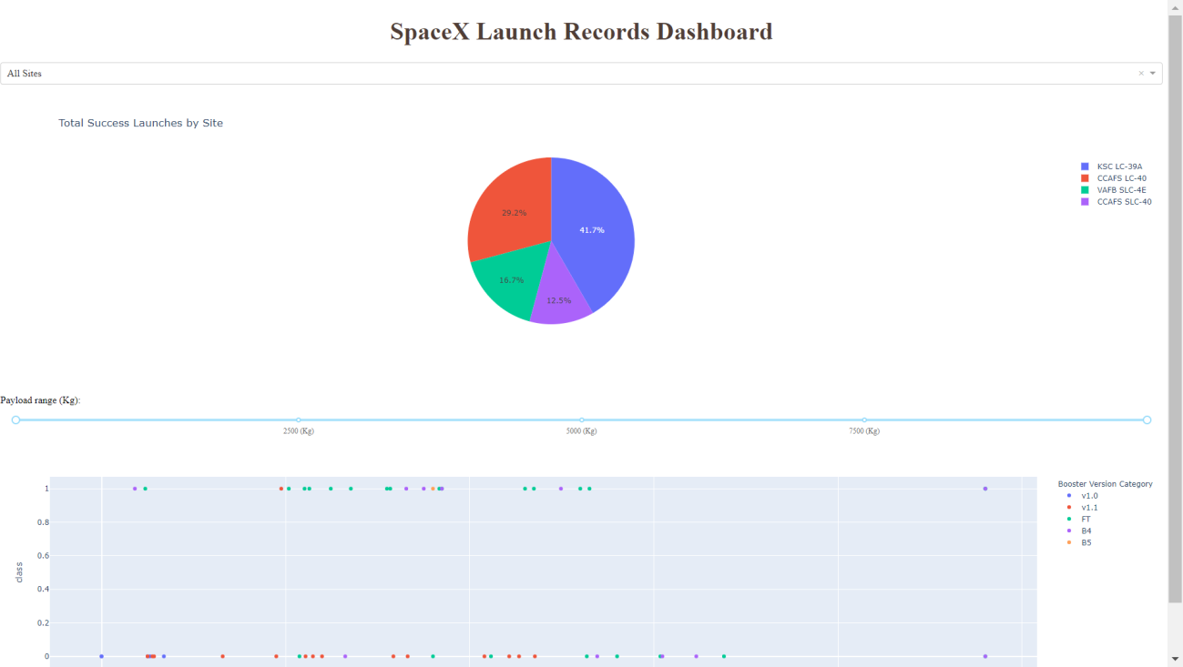
Results
This is a preview of the Plotly dashboard. The following sides will show the results of EDA with visualization, EDA with SQL, Interactive Map with Folium, and finally the resultsof our model with about 83% accuracy.

Slide 17

Section 2

Slide 18
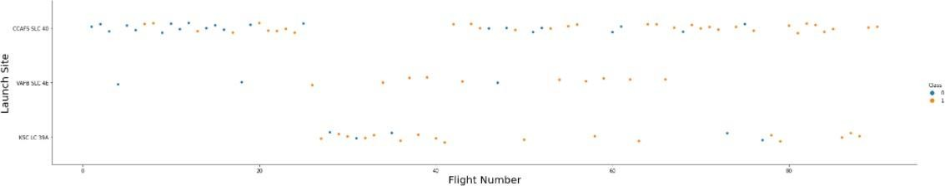
Flight Number vs. Launch Site
Orange: successful launch; blue: unsuccessful launch
Graphic suggests an increase in success rate over time (indicated in Flight Number). Likely a big breakthrough around flight 20 which significantly increased success rate. CCAFS appears to be the main launch site as it has the most volume.

Slide 19
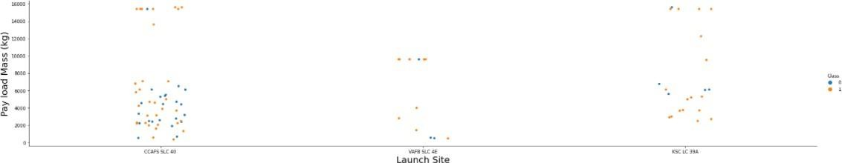
Payload vs. Launch Site
Payloadmass appears to fall mostly between 0-7000 kg. Different launch sites also seem to use different payload mass.

Slide 20
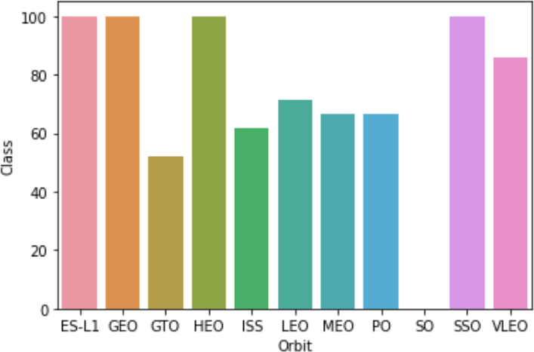
Success Rate vs. Orbit Type
Success Rate Scale with %
ES-L1 (1), GEO (1), HEO (1) have 100% success rate (sample sizes in parenthesis) SSO (5) has 100% success rate
VLEO (14) has decent success rate and attempts SO (1) has 0% success rate
GTO (27) has the around 50% success rate but largest sample

Slide 21
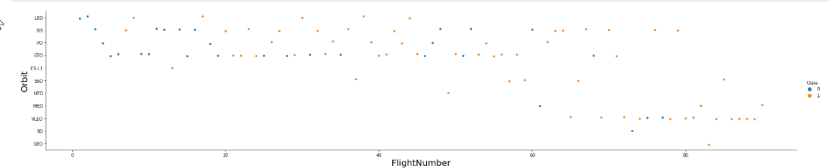
Flight Number vs. Orbit Type
Launch Orbit preferences changed over Flight Number. Launch Outcome seems to correlatewith this preference.
SpaceX started with LEO orbits which saw moderate success LEO and returned to VLEO in recent launches
SpaceX appears to perform better in lower orbits or Sun-synchronous orbits

Slide 22
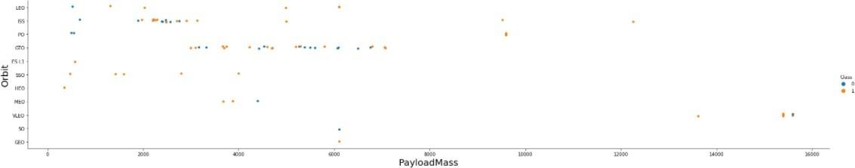
Payload vs. Orbit Type
Payload mass seems to correlatewith orbit
LEO and SSO seem to have relatively low payload mass
The other most successful orbit VLEO only has payload mass values in the higher end of the range

Slide 23
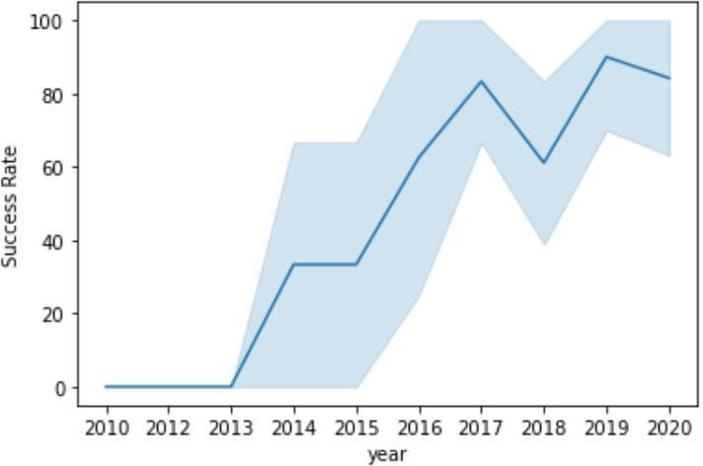
Launch Success Yearly Trend
95% confidence interval (light blue shading)
Success generally increases over time since 2013 with a slight dip in 2018 Success in recent years at around 80%

Slide 24
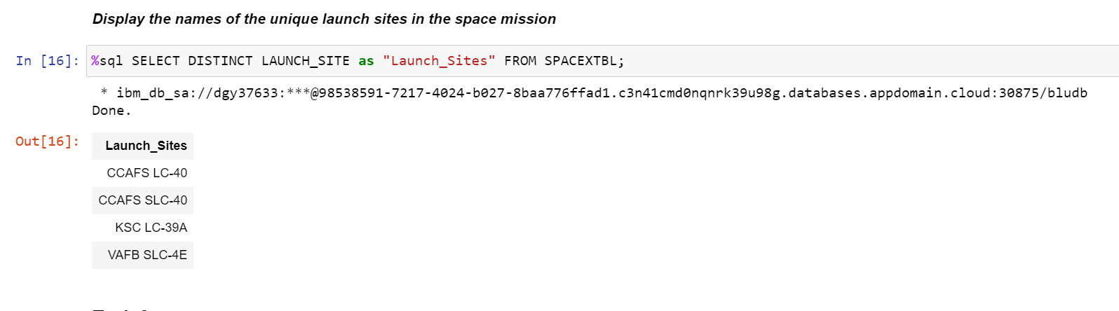
All Launch Site Names
The data contains several SpaceX launch facilities: Cape Canaveral Space Launch Complex 40, Vandenberg Air Force Base Space Launch Complex 4E and Kennedy Space Center Launch Complex 39A

Slide 25
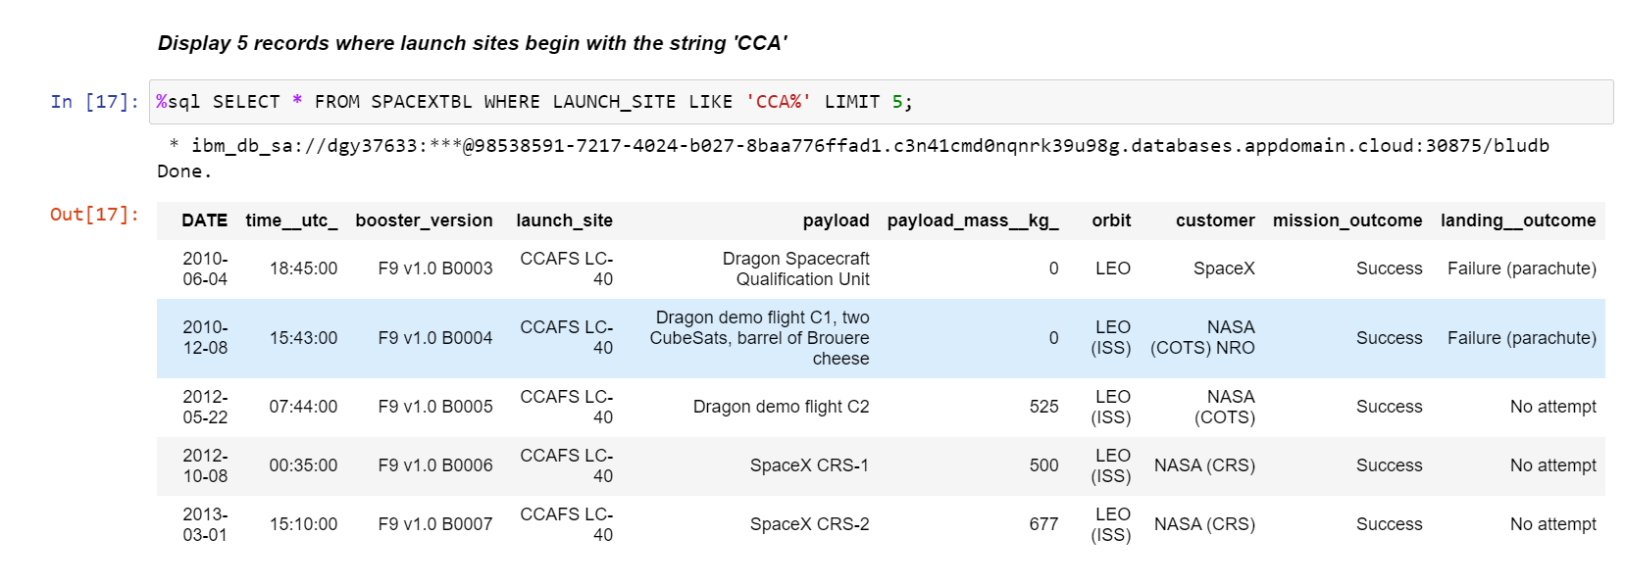
Launch Site Names Begin with 'CCA'

Slide 26
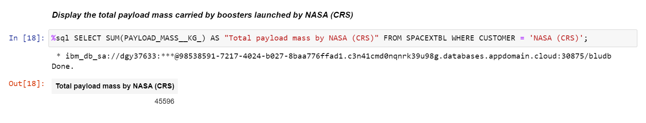
Total Payload Mass

Slide 27
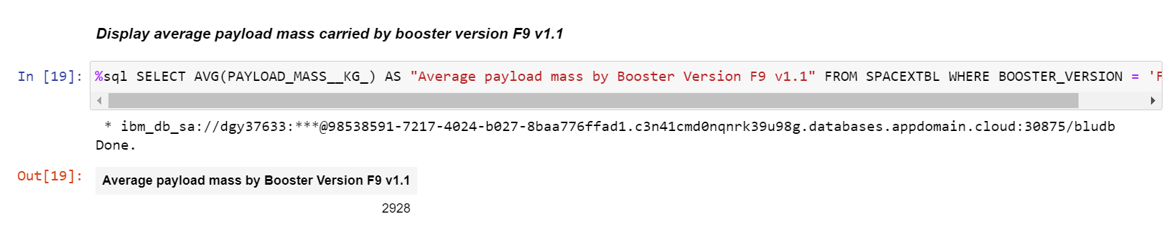
Average Payload Mass by F9 v1.1

Slide 28
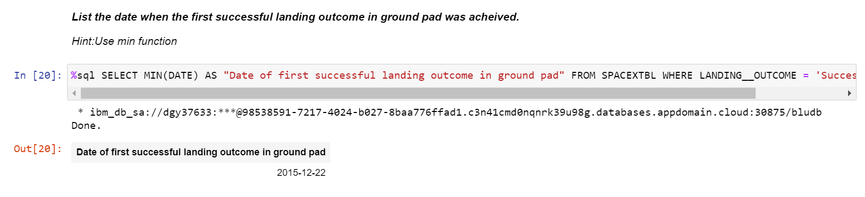
First Successful Ground Landing Date

Slide 29
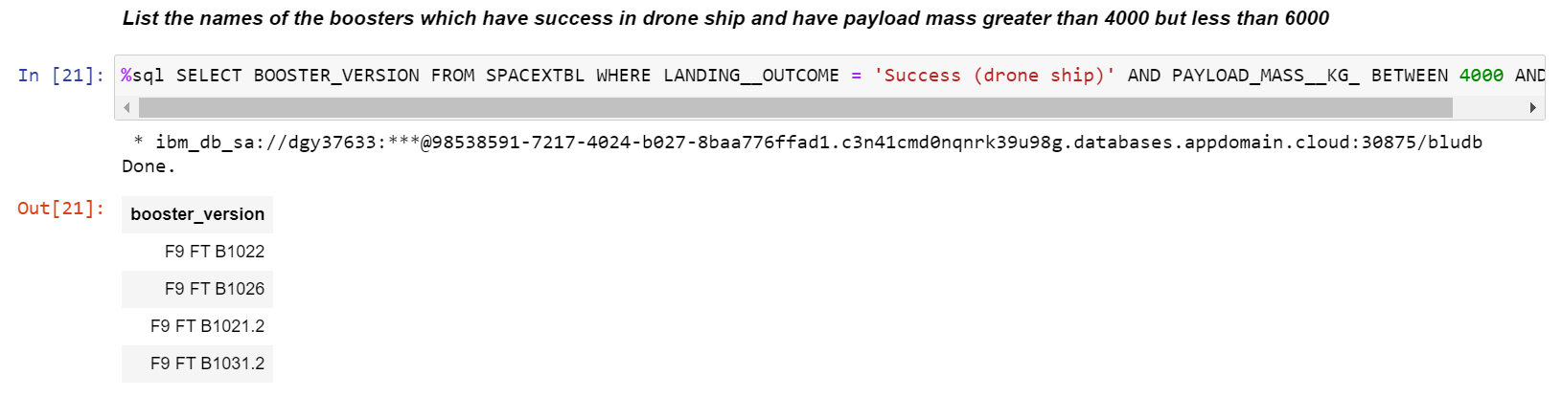
Successful Drone Ship Landing with Payload between 4000 and 6000

Slide 30
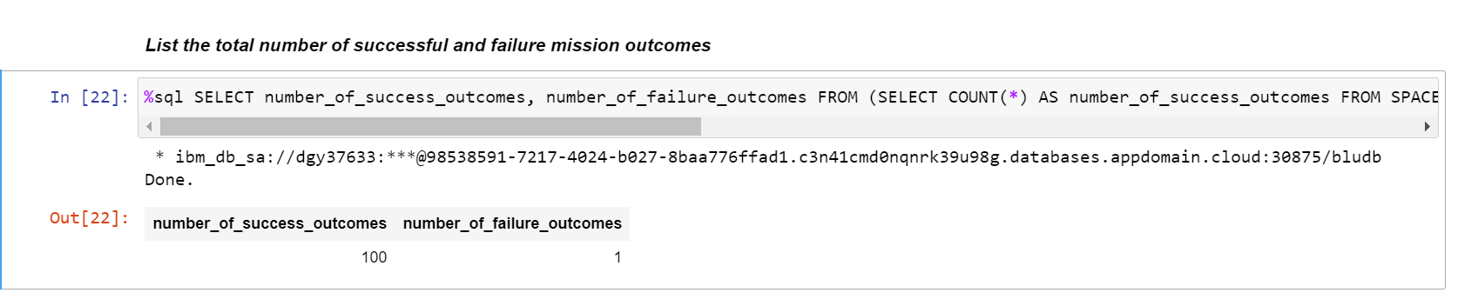
Total Number of Successful and Failure Mission Outcomes

Slide 31
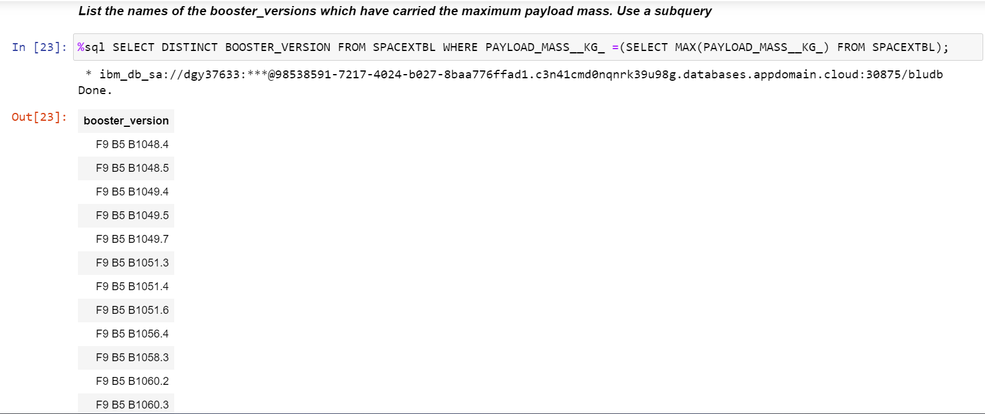
Boosters Carried Maximum Payload

Slide 32
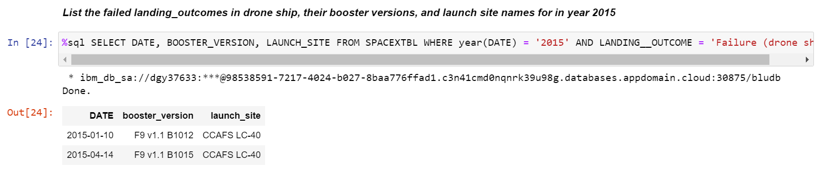
2015 Launch Records

Slide 33
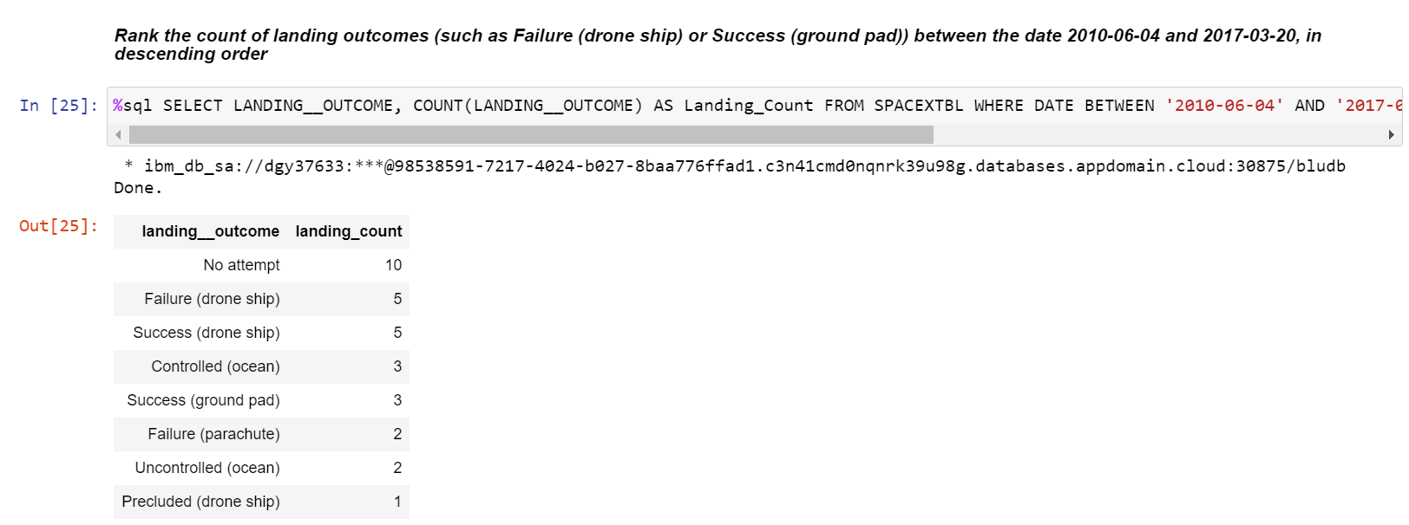
Rank Landing Outcomes Between 2010-06-04 and 2017-03-20

Slide 34

Section 3

Slide 35

Launch Site Locations on Global Map
The left map shows all launch sites relative US map. The right map shows the two Florida launch sites since they are very close to each other. All launch sites are near the ocean.

Slide 36

Color-coded launch markers
Clusters on Folium map can be clicked on to display each successful landing (green icon) and failed landing (red icon). In this example VAFB SLC-4E shows 4 successful landings and 6 failed landings.

Slide 37


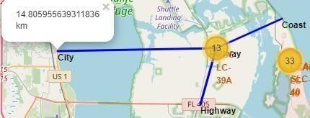
Key Locations Proximity
Using KSC LC-39A as an example, launch sites are very close to railways for large part and supply transportation. Launch sites are close to highways for human and supply transport. Launch sites are also close to coasts and relatively far from cities so that launch failures can land in the sea to avoid rockets falling in densely populated areas parts

Slide 38

Section 4

Slide 39
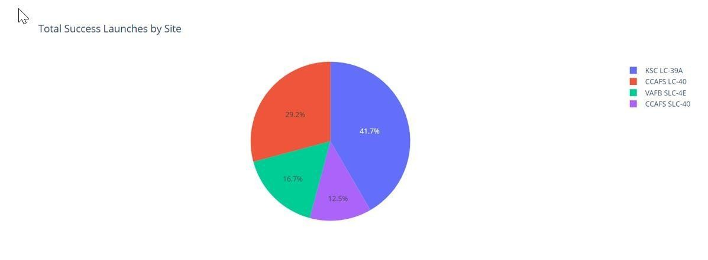

Successful launches across launch sites
This is the distribution of successful landings across all launch sites. CCAFS LC-40 is the old name of CCAFS SLC-40 so CCAFS and KSC have the same amount of successful landings, but a majority of the successful landings were performed before the name change. VAFB has the smallest share of successful landings. This may be due to a smaller sample and an increase in the difficulty of launching on the west coast.

Slide 40

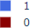
Highest Success Rate Launch Site
KSC LC-39A has the highest success rate with 10 successful landings and 3 failed landings.

Slide 41
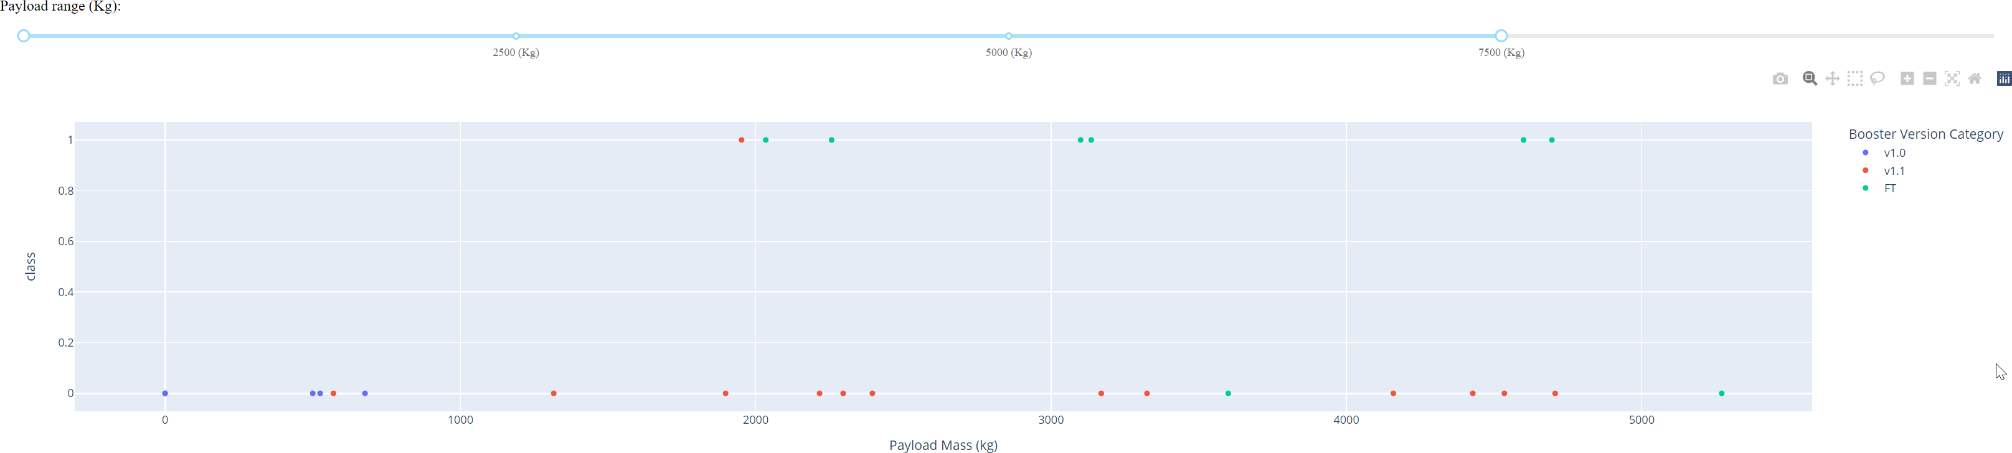
Payload Mass Vs Success Vs Booster Version
Category
Plotly dashboard has a Payload range selector. However, this is set from 0-10000 instead of the max Payload of 15600. Class indicates 1 for successful landing and 0 for failure. Scatter plot also accounts for booster version category in color and number of launches in point size. In this particular range of 0-7500, interestinglythere are two failed landings with payloads of zero kg.

Slide 42

Section 5

Slide 43
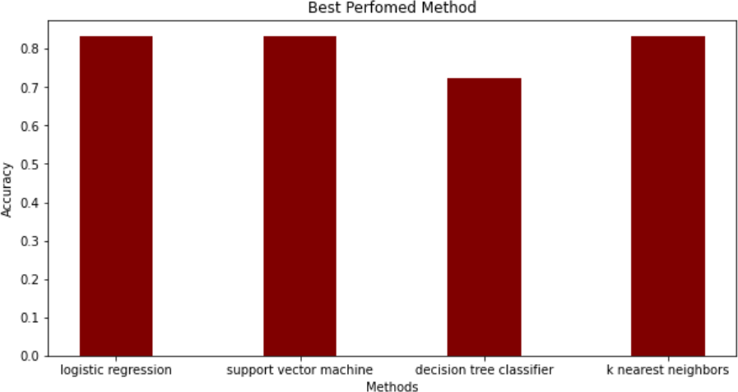
Classification Accuracy
The models had virtually the same accuracy on the test set at 83.33%accuracy, except the decision tree classifier with 72,23 %.
It should be noted that the test size is small at only a sample size of 18.
This can cause large variance in accuracy results, such as those in the Decision Tree Classifier model in repeated runs.

Slide 44

Confusion Matrix
Correct predictions are on a diagonal from top left to bottom right.
Since all models performed the same for the test set, the confusion matrix is the same across all models.
The models predicted 12 successful landings when the true label was successful landing.
The models predicted 3 unsuccessful landings when the true label was unsuccessful landing.
The models predicted 3 successful landings when the true label was unsuccessful landings (false positives).

Slide 45
Conclusions
Our task: to develop a machine learning model for Space Y which wants to bid against SpaceX
The goal of model is to predict when Stage 1 will successfully land to save ~ USD 100 million
Used data from a public SpaceX API and web scraping SpaceX Wikipedia page
Createddatalabels and storeddata intoa DB2 SQL database
Created a dashboard for visualization
We created a machine-learning model with an accuracy of 83%
Allon Mask of SpaceY can use this model to predict with relatively high accuracy whether a launch will have a successful Stage 1 landing before launch to determine whether the launch should be made or not
More data should be collected to better determine the best machine learning model and
Improve the accuracy

Slide 46


